Slide 1

Long-Tailed Image Recognition
Li Zhaochen
SCSE
Supervisor: Assoc Prof Chen Change Loy
10.05.2021
Notes:
Good afternoon, professors. Thank you for being here listening to my FYP presentation on long-tailed distribution on image recognition.

Slide 2
Content
Background
Why long-tailed data
Problem statement
Related work
Re-sampling/Re-weighting
Decoupling (Kang et al. 2020)
Proposed approach
Post-hoc fusion
Fusion baselines
Fine-tuning
Learnable Logits Weight (LLW)
Assignment Module (ASM)
Knowledge transfer
Results
Conclusion
Notes:
This presentation will cover the following parts of my project. For background, I will explain the meaning and the importance of long-tailed studies in deep learning, followed by the problem statement. For related work, I will briefly talk about traditional approaches when handling class-imbalance, such as re-sampling/re-weighing, but primarily focus on the recent classifier decoupling approach, as our work had some connections with it. Then I will introduce the two proposed approaches: 1st: a two-stage post-hoc fusion, that requires extra fine-tuning or calculation stage. 2nd: a one-stage end-to-end training with additional distillation loss on a student classifier. All of the proposed approaches beat baseline model’s performance, with some achieve the stage-of-the-art. Lastly, I will conclude with some reflections and possible future directions.

Slide 3
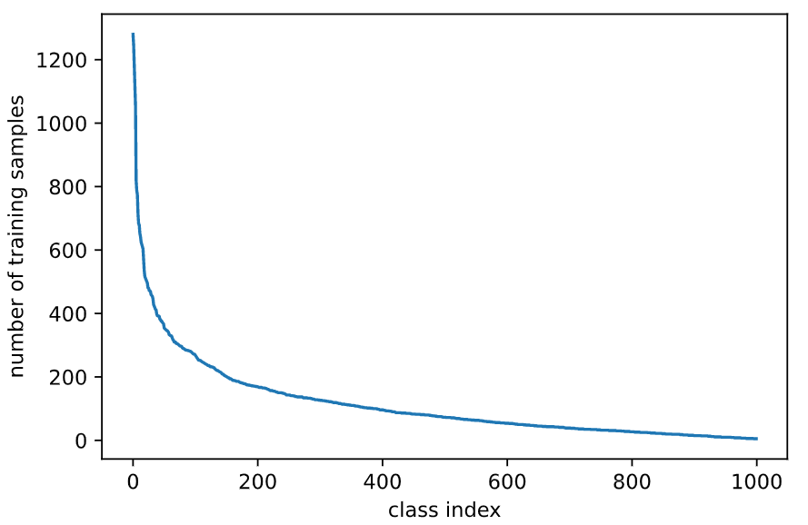
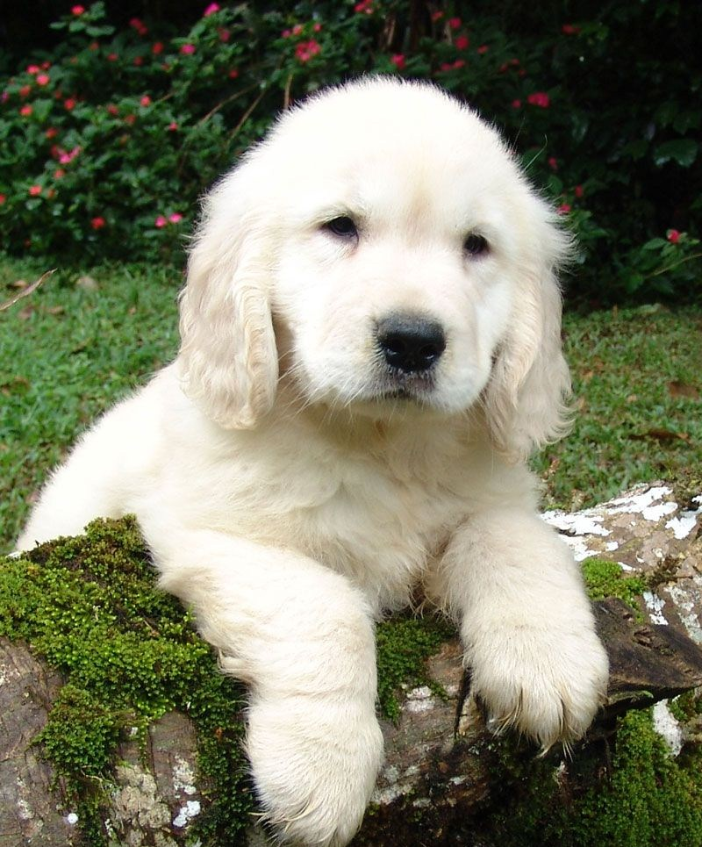
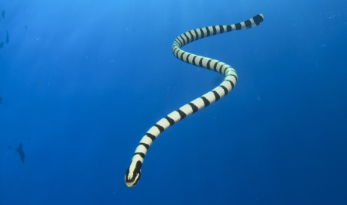
Background
What is long-tailed data and why do we study it?
Notes:
So, what is long-tailed data? And why do we have to study it? Over the years, large deep neural networks have shown
significant breakthroughs in the field of computer vision, thanks to the many large balanced dataset such as ImageNet and MS-COCO. However, real-world data is often long-tailed in nature, with a few classes contribute to most of the training samples, and most classes are under-represented. This can be due to the difficulty in data collection. For example, it is much easier to collect pictures of dog, than pictures of, say, sea snake. Standard deep learning training strategy makes the network highly skewed towards the data rich classes, but perform poorly on the data-scarce tail classes.

Slide 4

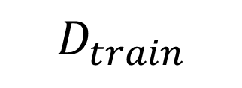
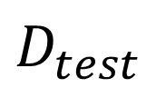
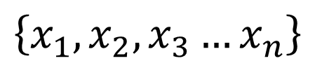
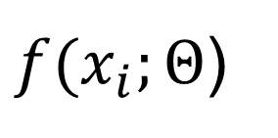
Problem statement
$$\left\{x_{1},x_{2},x_{3}…x_{n}\right\}$$
$$D_{train}$$
$f(x_{i};Θ$)
$$D_{test}$$
Notes:
With that, we now give the problem statement of our image classification task: we aim to learn a model f, parameterized by theta, from a long-tailed dataset, D_train, such that the model achieves optimal performance on a class-balanced test set D_test with some evaluation metrics (we use accuracy throughout this project)

Slide 5
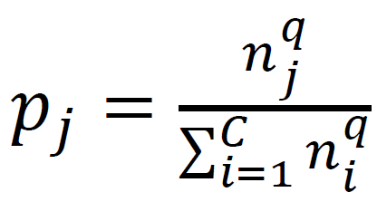
Related works
Re-sampling
Over-sampling/under-sampling
Class-balanced sampling: q = 0
Drawbacks: Over-fitting, under-fitting
Notes:
The long-tailed problem can be seen as a special case of class-imbalance. Traditional method like data re-sampling, typically over-sample minority classes or under-sample majority classes. For long-tailed data, most of the sampling strategies can be summarized in the equation shown here, where pj is the probability of sampling input x from class j, nj is the number of training samples from class j and q is a parameter controlling the sampling probability. When we set q equal to 0, we get a class-balanced sampler where each class has equal change of being sampled. While such sampling is easy and straightforward, it suffers from over-fitting or under-fitting.

Slide 6
Related works
Re-weighting
Assign higher weight to minority classes
Eg: Inverse of class-frequency, focal-loss
Drawbacks: Difficulty and instability in optimizaiton
Noise, Mislabel
Notes:
Another approach is along loss –reweighting. Minority or tail classes are given a higher weight, which can be calculated by the inverse-of class-frequency, or hard example mining like focal loss. However, as pointed out in some prior work: that loss-reweighting will lead to difficulty and instability in optimization, as there might be noisy or mislabeled samples.

Slide 7
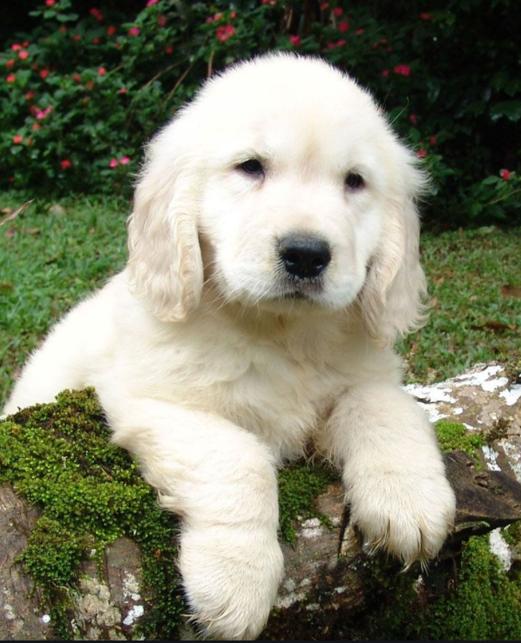
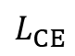
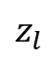



Related works
Classifier decoupling
Standard Training Architecture
GAP
FC
CNN
h
$$z_{l}$$
$$L_{CE}$$
$$Θ_{rep}$$
$$Θ_{cls}$$
$$x$$
Instance-balanced sampling
Class-balanced sampling
Notes:
A more recent approach is classifier decoupling. Here is a standard training architecture. The it consists of a CNN backbone network that produce feature h, followed by a fully connected layer, that is typically a dot product classifier to yield logits z, which is a 1d vector with length equal to the total number of class index. In the classifier decoupling approach, the whole model is first jointly trained with instance-balanced sampling, such that the backbone network can product high quality feature representations. Then, and classifier is finetuned with class-balanced sampler while backbone parameters are freezeed.

Slide 8
Related works
Nearest Class Mean (NCM) classifier
Standard Training Architecture
GAP
FC
CNN
h
$$z_{l}$$
$$L_{CE}$$
$$Θ_{rep}$$
$$Θ_{cls}$$
$$x$$
M
C * feat_dim
Notes:
With the backbone CNN, a memory module, M, can be calculated by passing all training samples into the network, and calculate feature centroids per class. It should have tensor size of C * feature dimension, where C is the total number of class index.

Slide 9
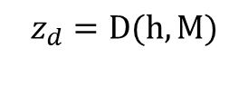
Related works
Nearest Class Mean (NCM) classifier
Standard Training Architecture
GAP
NCM
CNN
h
$$z_{d}=D(h, M)$$
$$Θ_{rep}$$
$$x$$
M
Notes:
The memory module is then used for non-parametric NCM classifier, which calculates distance D between input feature and feature centroids for every class. So we get Zd, which has the same shape as Zl. During inference, the class whose feature centroid that is the closest to the feature is the model’s prediction. So in that sense, NCM classifier is a version of KNN classifier.

Slide 10
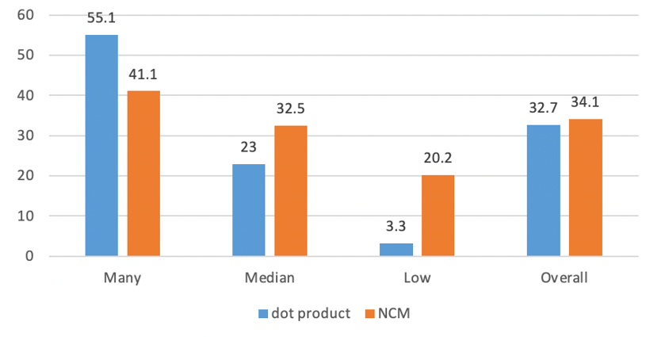
Related works
NCM classifier on ImageNet-LT
Notes:
Here we show the comparison between NCM classifier and the standard dot product classifier using ResNet-10, under instance-balanced sampling on ImageNet_LT. Besides the overall accuracy, we further report on three splits: Many, Median, Low. It can be seen in orange line, that the simple non-parametric NCM classifier outperforms the dot product classifier on overall, median, and particularly on the low classes. This findings motivates us to come out with our proposed approaches

Slide 11
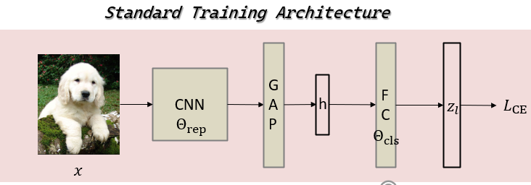
Proposed approach
Post-hoc fusion
Notes:
Our first approach is post-hoc fusion, which fuse the output from NCM classifier together with the dot product output.

Slide 12


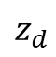
Proposed approach
Post-hoc fusion
NCM
M
$$z_{d}$$
Notes:
With NCM classifier described above, we can get the distance as logits Zd, which give far better accuracy on median and low classes. So the question is can we merge the two logits to ameliorate the performance on tail, while maintaining the good performance on head? The answer is yes. But we have to manipulate the logits Zd a bit due to difference in scale.

Slide 13
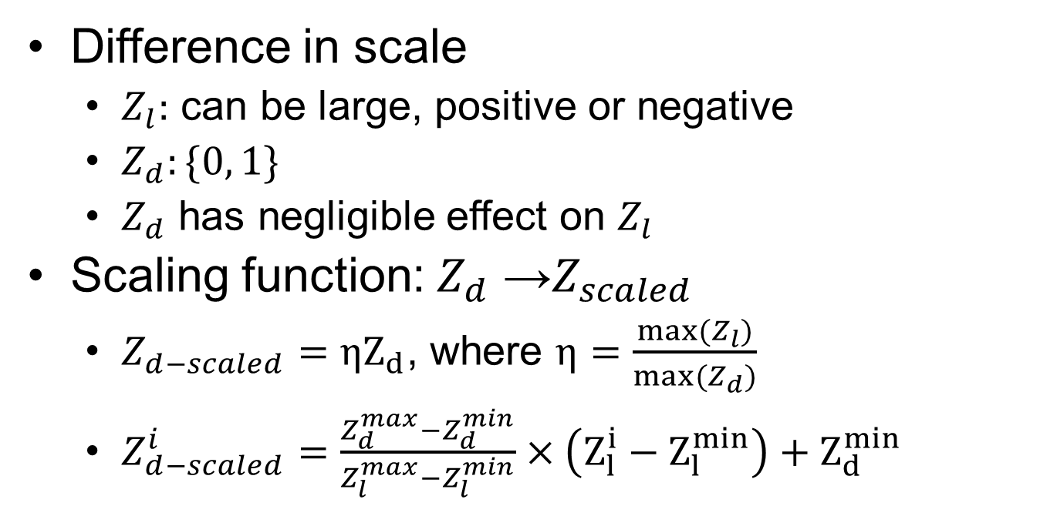
Post-hoc fusion
Difference in scale
$Z_{l}:$ can be large, positive or negative
$Z_{d}:\{0, 1\}$
$Z_{d}$ has negligible effect on $Z_{l}$
Scaling function: $Z_{d}$ →$Z_{scaled}$
$Z_{d−scaled}=ηZ_{d}$, where $η=\frac{max⁡(Z_{l})}{max⁡(Z_{d})}$
$Z_{d−scaled}^{i}=\frac{Z_{d}^{max}−Z_{d}^{min}}{Z_{l}^{max}−Z_{l}^{min}}×\left(Z_{l}^{i}−Z_{l}^{min}\right)+Z_{d}^{min}$
Notes:
A common distance metric used on vector space is cosine similarity, which makes Zd between the range 0 to 1. However, Zl can be very large and can be both + and negative, depending on how the model converges. So Zd has negligible effect on Zl. Therefore, we propose two scaling function for Zd to put it on the same scale as Zl, which is shown by the two equations here. The first one is to add a weight coefficient, that is calculated as the division of the two max values. The second one is a more carefully crafted min-max scaling, that makes sure the min and max value of the two are the same. We will shown in our experiment results later that the second scaling function is surpirior than the first.

Slide 14
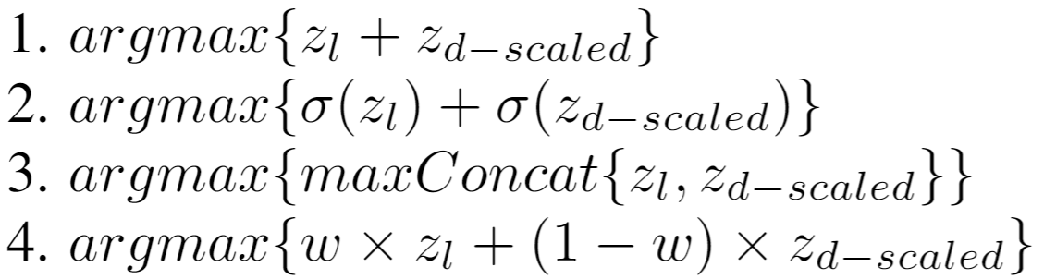
Post-hoc fusion
Fusion baselines
Notes:
So with the two logits on the same scale, we first propose four merge mechanisms, which we term as fusion baselines, as this just require simple calculation. The first one is a direct sum on the two logits, the second one is to first pass through the logits into the softmax normalization layer, followed by a direct sum. The third one is to apply the max operation on the two logits, and concat the result together. The last one is a weighted sum, with weight w caliberated between 0 and 1.

Slide 15
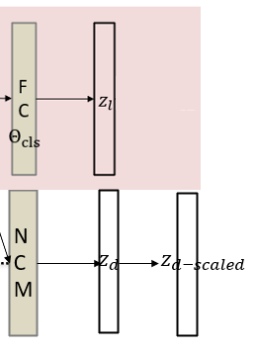
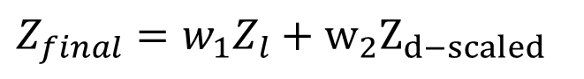
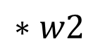
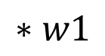
Post-hoc fusion
Fine-tuning
Learnable Logits Weight (LLW)
$$∗w1$$
$Z_{final}=w_{1}Z_{l}+w_{2}Z_{d−scaled}$
$$∗w2$$
Freeze model parameters
10 epochs of finetuning
Notes:
We also extend fusion to fine-tuning strategies. The learnable logits weight can be seen as a special case of the last weighted sum fusion baseline, but instead of manually tuning the weight parameter w, we assign them as learnable parameters w1, w2. Their weighted sum give us the final logits Z final. After baseline model’s training is complete, we use z-final as logits and finetune for 10 epochs while all other parameters are freezed. So only w1 and w2 is updated through back propagation. We term this approach as LLW, or learnable logits weight

Slide 16
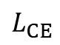
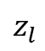


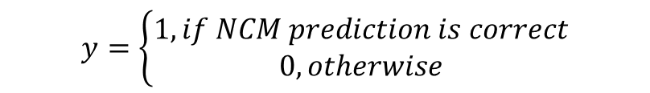


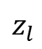
Post-hoc fusion
Fine-tuning
Assignment Module(ASM)
normalize
Standard Training Architecture
nn.linear, nn.ReLU
h
GAP
FC
nn.linear,
torch.sigmoid
CNN
torch.cat
$$L_{bce}$$
h
$$z_{l}$$
$$L_{CE}$$
$$Θ_{rep}$$
Top k
$$Θ_{cls}$$
$$z_{l}$$
$$x$$
$$y=\left\{\begin{aligned}1, if NCM prediction is correct \\ 0, otherwise\end{aligned}\right.$$
Notes:
Another finetuning strategy is called assignmented module, which is a Multi-Layer perceptron architecture with binary cross entropy loss that takes feature h and logits as input, it first normalize feature h, and project it to a lower dimension. Then concat it with the topk logits. The k values is adjusted based on the total number of classes of the dataset we use. The final concatenated value is then fed into a linear layer followed by a sigmoid function to calculate binary cross entropy loss. The ground truth value y is a Kronecker delta function, which is 1 if NCM classifier predicts correctly and 0 otherwise. Similarly, ths assignment module is finetuned for 10 epochs while all other parameters are freezed.

Slide 17
Post-hoc fusion
Fine-tuning
Assignment Module(ASM)
Prediction from dot product classifier
Prediction from NCM classifier
1
ASM
0
Notes:
During inference, when we pass in a test image, we get two predictions: one from the dot product classifier, and the other from the NCM classifier. We will rely on the asm module to tell us which prediction we take.

Slide 18
Knowledge transfer
Drawback of Post-hoc fusion
Require two stages
End-to-End: incorporate NCM classifier into training phase?
Notes:
Now, one of the drawbacks of the above-mentioned post-hoc fusion methods is that they all require two stages. The memory module is calculated at the end of first stage training. The next question is how can we incorporate NCM classifier and the memory module into a one-stage end-to-end training strategy

Slide 19
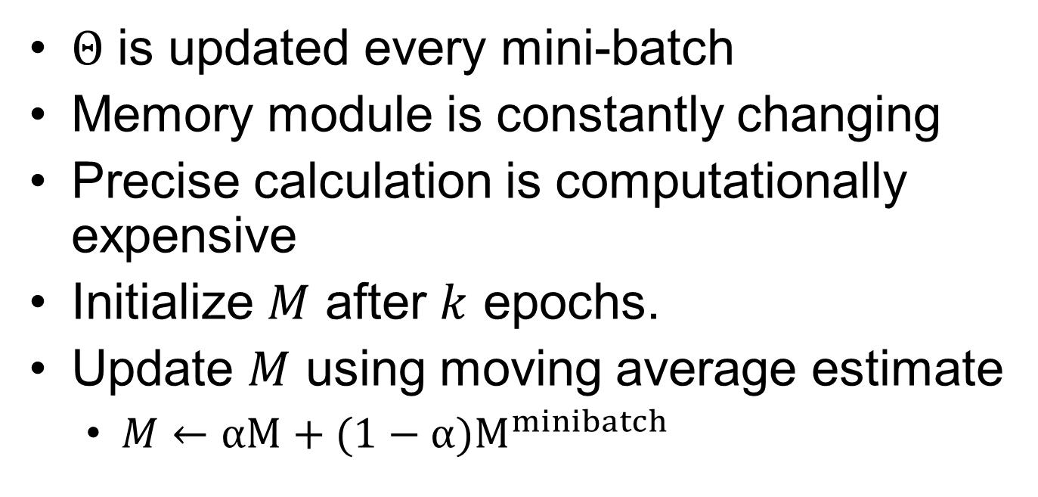
Knowledge transfer
$Θ$ is updated every mini-batch
Memory module is constantly changing
Precise calculation is computationally expensive
Initialize $M$ after $k$ epochs.
Update $M$ using moving average estimate
$M←αM+(1−α{)M}^{minibatch}$
Notes:
Recall that a modern deep learning training strategy calculates gradient w.r.t loss and performs parameter updates per mini-batch. A pair of exactly same input images would have two different feature vectors before and after one update, and the number of updates in the entire training phase can be very frequent, determined by batch size and the number
of training samples. A naive and most accurate solution is to perform a re-calculation of memory after each update, but it is very computational costly. we
adopt the momentum update mechanism to solve this issue. Formally, we initialize M after some k epochs of training, and update M using a moving average estimate per minibatch. Alpha is the momentum coefficient that is usually a value close to one.

Slide 20
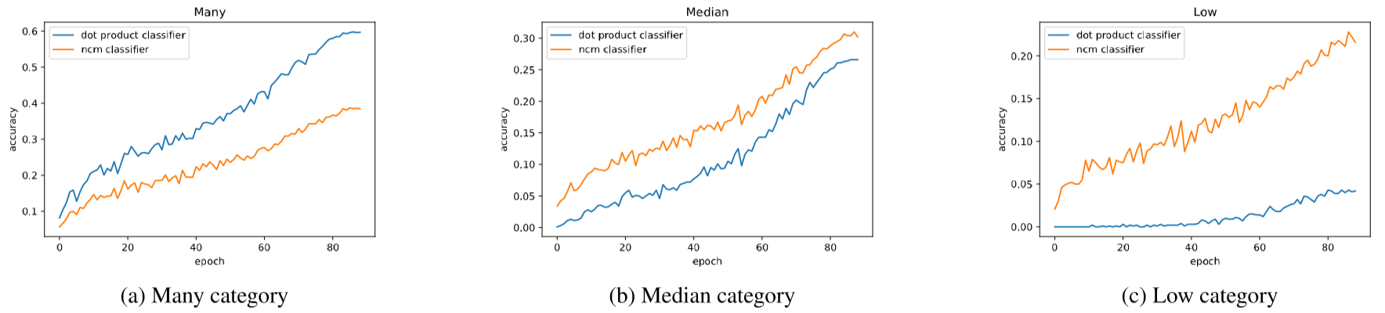
Knowledge transfer
Performance
Updated (34.1%) vs Final (35.3%)
Updated NCM vs Dot Product
Notes:
With that, we analyse the performance of NCM classifier on the updated memory and final memory. It achieve decent overall accuracy of 34.1% compare to using the final memory which is 35.3%. We also compare it with dot product classifier on the balanced validation set after each epoch of training. Similarly, as seen in the orange line, NCM classifier with the updated memory module outperforms dot product classifier on median and low category.

Slide 21
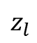

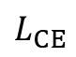
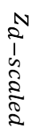
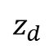
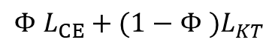
Knowledge transfer
FC
Student
$$z_{l}$$
$${Φ L}_{CE}+{(1−Φ )L}_{KT}$$
$${\tilde{Θ}}_{cls}$$
$$L_{CE}$$
NCM
Detached from the second classifier’s computational graph
M
$$z_{d−scaled}$$
$$z_{d}$$
scaling
Teacher
Notes:
This suggests that NCM classifier can be potentially used as a teacher. Borrowed from knowledge distillation, we add a Kullback-Leibler Divergence loss term on an additional dot product classifier, which has the exactly same architecture. We treat NCM output as teacher, and the additional dot product classifier as student. The only difference between the two dot product classifiers is that the second one is trained with both Cross entropy loss and the knowledge transfer loss. Another thing to note it that the backbone parameters are detached from the student’s computational graph. This it to make sure that the feature extracted is unaffected by the additional supervision.

Slide 22
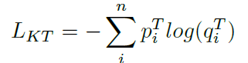
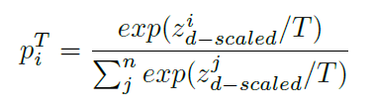
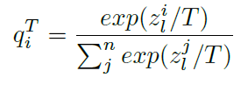
Knowledge transfer
Notes:
The knowledge transfer loss is calculated as follows, p I t, the teacher is the normalized logits from NCM classifier, and q I t is, the student, Is from the second dot product classifier. T is the temperature value, which for standard softmax is set to 1.

Slide 23
Knowledge transfer
Masking mechanism
Not all “teacher” is correct
KT-Tail: Only tail classes go through distillation
KT-DM: A dynamic mask where only inputs with correct “teacher” prediction go through distillation.
Notes:
In practice, we also adopt the masking mechanism, as we have seen previously in the performance comparison, NCM classifier does not perform well on head classes, and there can be cases where NCM classifier predicts wrongly but the dot product classifier predicts correctly. So we have KT-Tail, which makes sure only tail classes go through the knowledge transfer loss, and a dynamic mask KT-DM, which creates a mask for each minibatch based on predictions from NCM classifier. . Only inputs which are correctly predicted by NCM classifier would under go the knowledge transfer loss while the rest inputs are supervised with purely cross entropy loss.

Slide 24
Experiment
Dataset and experiment settings.
CIFAR-LT, ImageNet-LT
CIFAR-LT
ResNet-32
200 epochs
ImageNet-LT
ResNet-10, ResNet-50, ResNeXt-50
90 epochs
Notes:
After hearing all of our proposed approach, I will now report our experiment results. We use CIFAR-LT and ImageNet-LT for experiments. For faire comparison, we adopt resnet-32 and 200 epochs of training for cifar-lt, and resnet-10, 50 resnext50 and 90 epochs for imagenet-lt. All the experiment settings and hyperparameters such as learning rate, weight decay etc are inline with previous work’s setting.

Slide 25
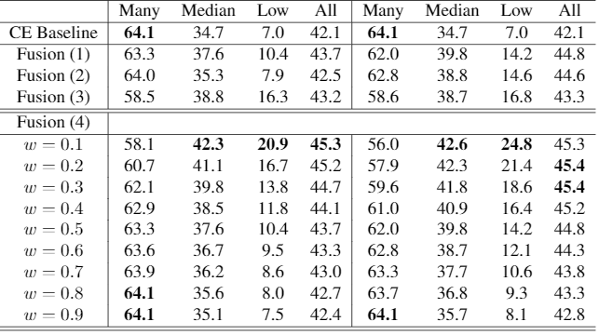
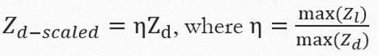
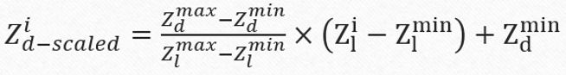
Experiment result
Fusion baselines and scaling functions
Notes:
We first show our four fusion baselines and the two propose scaling functions, USING Resnet50 on imagenetlt,. Vertically, we can see all the propose fusion mechanisms outperform baseline, with the carefully searched weight parameter for the weighted sum give the best result. Horizontally, the second scaling function on the rightmost column outperform its counterpart throughout all the ex[eriments.

Slide 26
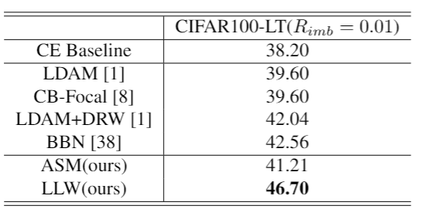
Experiment result
Fine-tuning
CIFAR100-LT, ResNet-32
Notes:
For cifar100-lt . We can see our LLW achieves 8,5% gains and outperforms some of the previously-proposed method like BBN and Label Distribution Aware margin loss.

Slide 27
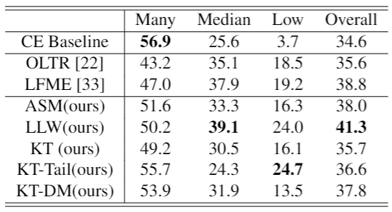
Experiment result
Fine-tuning and knowledge transfer
ImageNet-LT, ResNet10
Notes:
For the large scale imagenet-lt, on resnet10, our finetuning strategies asm and llw achieves 3.4 and 6,7% accuracy gains compare to baselines. Our knowledge transfer loss achieves a slightly smaller gains, but the results, especially the performance of KT-Tail on low class, manifests its effectiveness. When comparing to previous work like OLTR and LFME, our propose LLW method has the best performance on all classes.

Slide 28
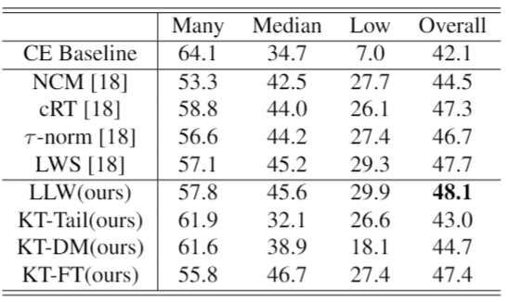
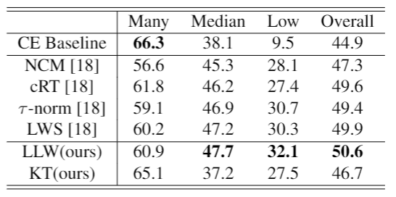
Experiment result
ResNet-50
ResNeXt-50
Notes:
We also did experiment on larger networks like resnet50 and resnext50. Similarly, our LLW gives better performance compare to the four classifier decoupling approaches proposed by Kang et al.

Slide 29
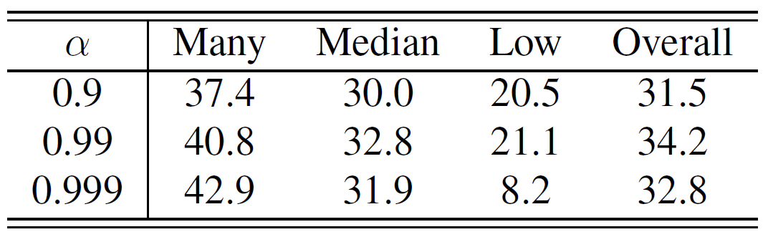
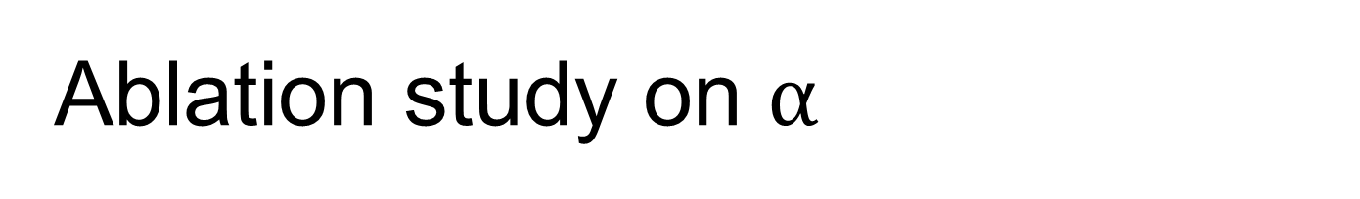
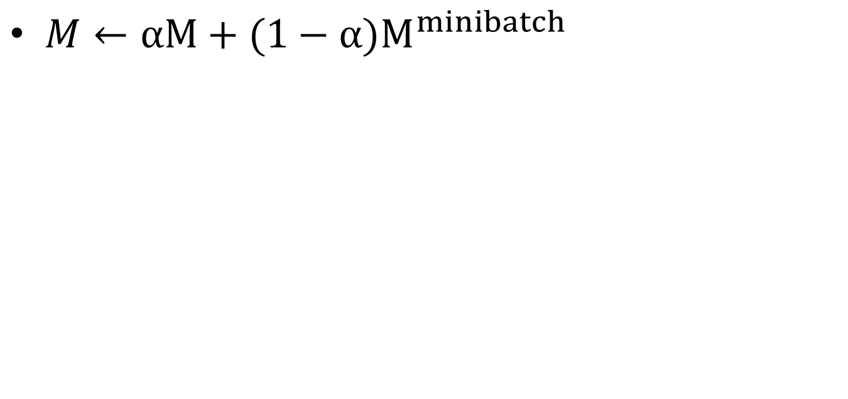
Ablation study on $α$
$M←αM+(1−α{)M}^{minibatch}$
Notes:
For ablation study, we did some experiment on how alpha affect the NCM classifier’s performance on the updated memory module, we select 0.9, 0.99 and 0.999 and the performance doesn’t vary much ,alrhough 0.999 have worst performance on Low classes.

Slide 30
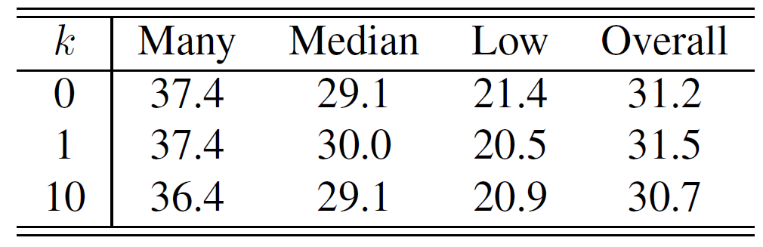
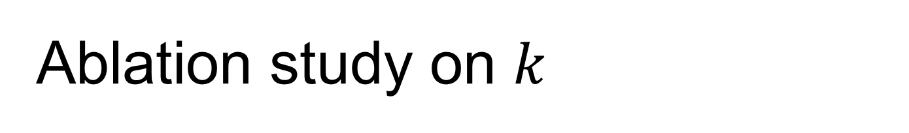
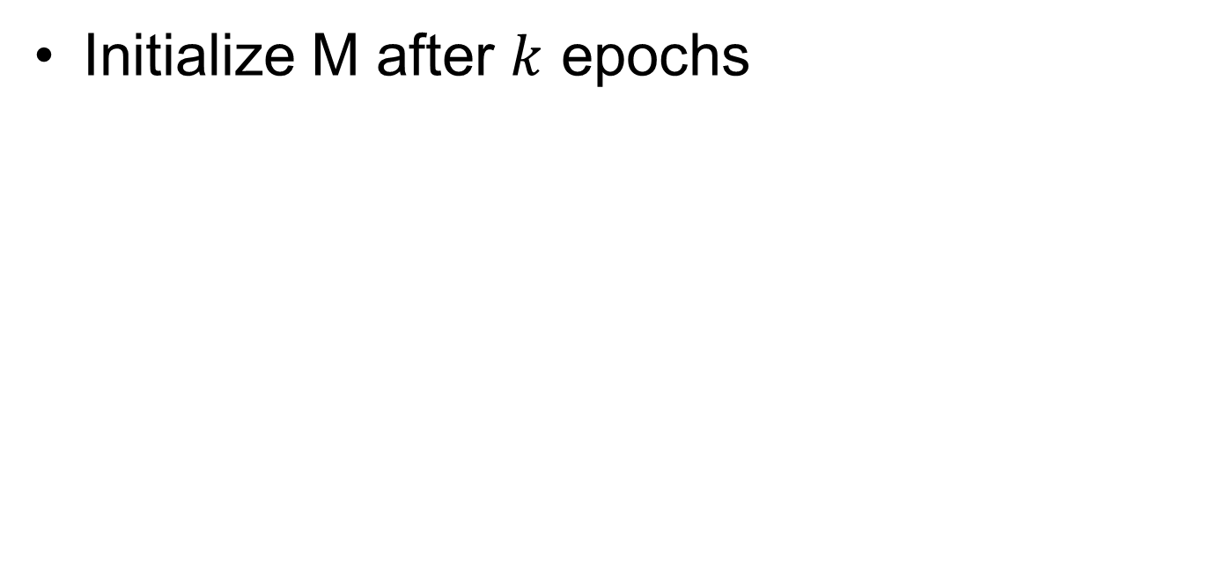
Ablation study on $k$
Initialize M after $k$ epochs
Notes:
As for the values of k, which determines the starting epoch to initialize M, we select 0, which initializes m completely random, and 1 and 10. The results is also quite stable, suggests that the updated memory module is not very sensitive to this hyperparameters.

Slide 31
Conclusion
Novel approach harnessing the effect of non-parametric NCM classifier
Trade-off between accuracy on head and tail classes still exists
Notes:
In conclusion, we have proposed several novel approaches harnessing the non-parametric NCM classifier on long-tailed image classification task. However, we can still observe the trade-off between accuracy on head and tail classes, which is not desirable. For future work, we could explore more efficient merging functions besides the two proposed functions to seek better performance and possibly minimize the trade-off.

Slide 32
Q&A

Slide 33
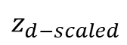
NCM
M
$$z_{d}$$
$$z_{d−scaled}$$

